Slide 1
Nxp oasis AI/ML RUNTIME SOFTWARE ARCHITECTURE
Jianfeng qin
lIN tao
DongshenG zhang
V1.0
may, 2019

Slide 2
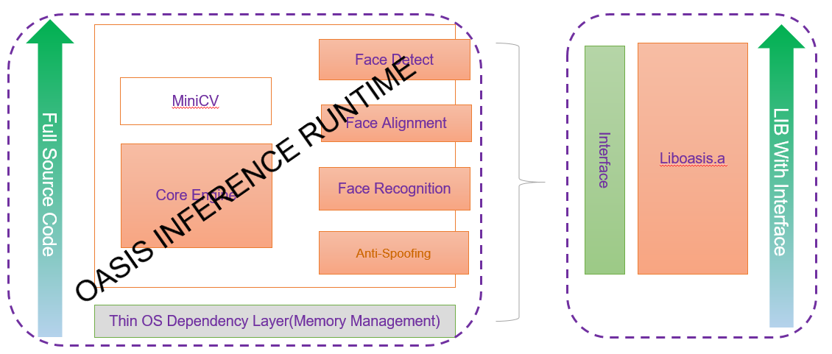
Oasis Architecture:

Slide 3
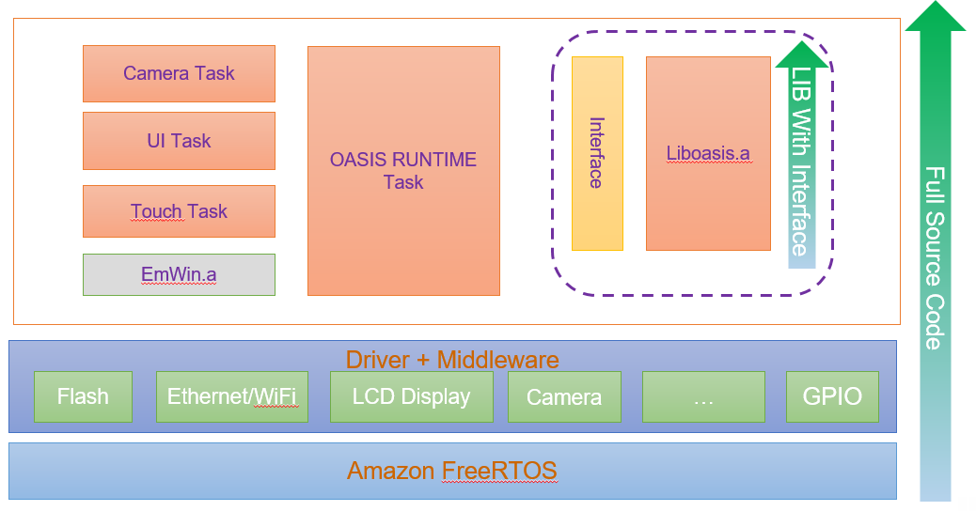
Mcu face secure aRCHITECTURE

Slide 4
BACKUP

